Slide 1
Session 7
Overview of Signs and Symptoms

Slide 2
INDICATORS CONSISTENT WITH DRUG CATEGORIES
 | CNS Depressants | CNS Stimulants | Hallucinogens | Dissociative Anesthetics | Narcotic Analgesics | Inhalants | Cannabis
HGN
VGN
LOC
Pupil Size
Reaction to Light
Pulse Rate
Blood Pressure
Body Temperature
Muscle Tone
Present
None
None
Present
None
Present
None
Present
(High Dose)
Present
(High Dose)
None
None
Present
None
None
Present
None
None
Present
None
Present
Present
Normal (1)
Dilated
Dilated
Normal
Constricted
Normal (4)
Dilated (6)
Slow
Slow
Normal (3)
Normal
Little or None Visible
Slow
Normal
Down (2)
Up
Up
Up
Down
Up
Up
Down
Up
Up
Up
Down
Up/Down (5)
Up
Normal
Up
Up
Up
Down
Up/Down/Normal
Normal
Flaccid
Rigid
Rigid
Rigid
Flaccid
Normal or
Flaccid
Normal
FOOTNOTE: These indicators are those most consistent with the category, keep in mind there may be variations due to individual reaction, dose taken and drug interactions.
(1) Soma, Quaaludes, and some anti-depressants usually dilate
(2) ETOH, Quaaludes, and some anti-depressants may elevate.
(5) Down with anesthetic gases, up with volatile solvents and aerosols.
(3) Certain psychedelic amphetamines may cause slowing.
(4) Possibly dilated.
(6) Possibly normal.

Slide 3
Learning Objectives
Give examples of specific drugs belonging to the seven drug categories
Describe major signs and symptoms of impairment associated with each category

Slide 4
Sign and Symptom Definition
Sign: An observable or detectable indicator of drug influence
Symptom: A subjective indicator of drug influence reported by the drug-impaired subject

Slide 5
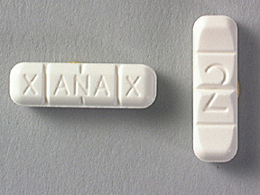
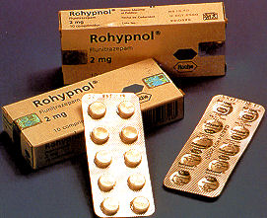
CNS Depressants
HGN
VGN
LOC

Slide 6
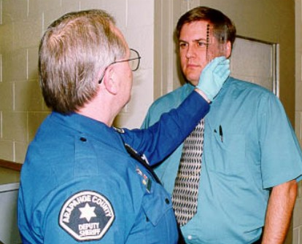
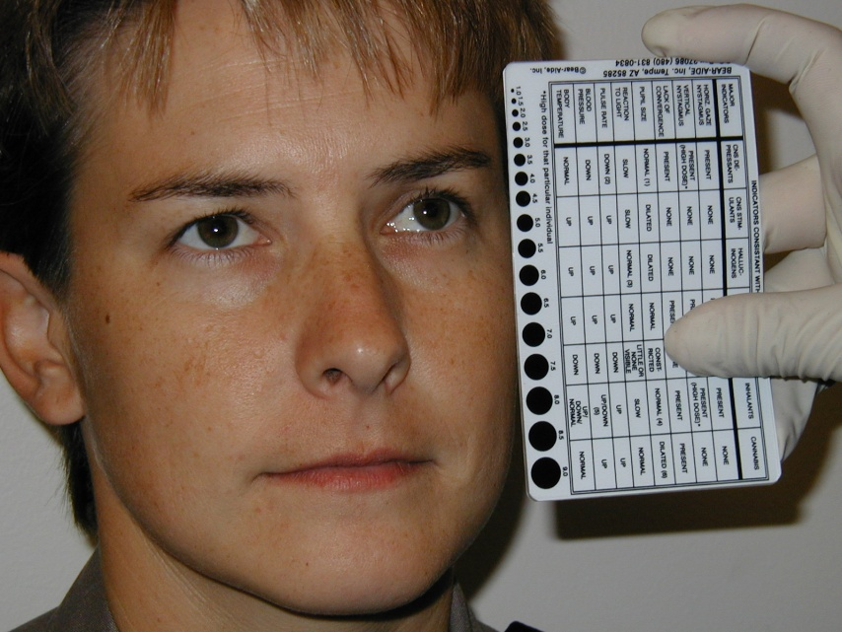
CNS Depressants
Pupil Size
Reaction to Light

Slide 7
CNS Depressants
Vital signs
Pulse rate
Blood pressure
Body temperature
Muscle tone

Slide 8
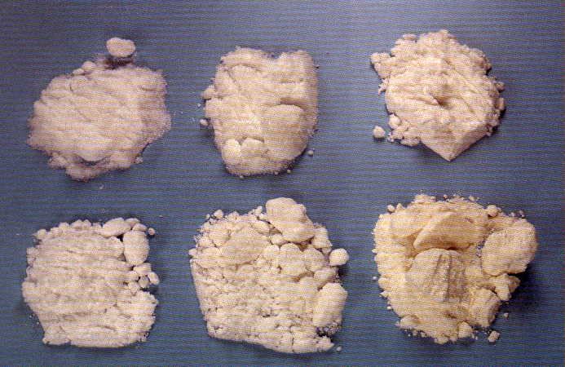
CNS Stimulants
HGN
VGN
LOC

Slide 9
CNS Stimulants
Pupil size
Reaction to light

Slide 10
CNS Stimulants
Vital signs
Pulse rate
Blood pressure
Body temperature
Muscle tone

Slide 11
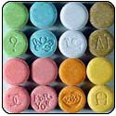
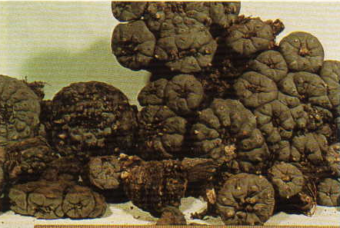
Hallucinogens
HGN
VGN
LOC

Slide 12
Hallucinogens
Pupil Size
Reaction to Light

Slide 13
Hallucinogens
Vital signs
Pulse rate
Blood pressure
Body temperature
Muscle tone

Slide 14
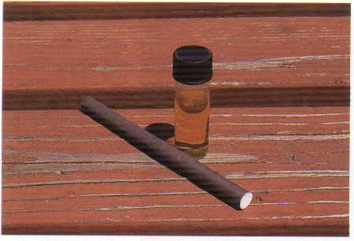
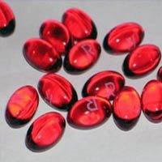
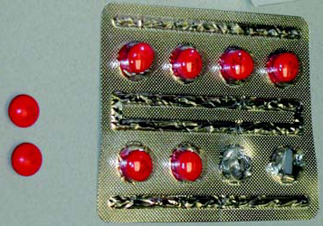
Dissociative Anesthetics
HGN
VGN
LOC

Slide 15
Dissociative Anesthetics
Pupil Size
Reaction to Light

Slide 16
Dissociative Anesthetics
Vital signs
Pulse rate
Blood pressure
Body temperature
Muscle tone

Slide 17
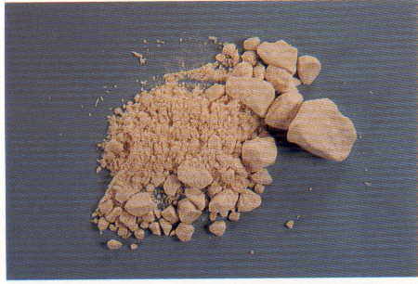
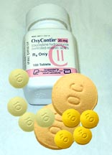
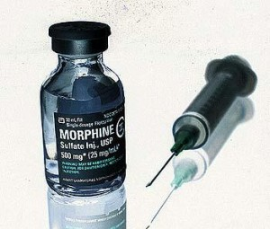
Narcotic Analgesics
HGN
VGN
LOC

Slide 18
Narcotic Analgesics
Pupil Size
Reaction to Light

Slide 19
Narcotic Analgesics
Vital signs
Pulse rate
Blood pressure
Body temperature
Muscle tone

Slide 20
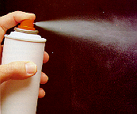
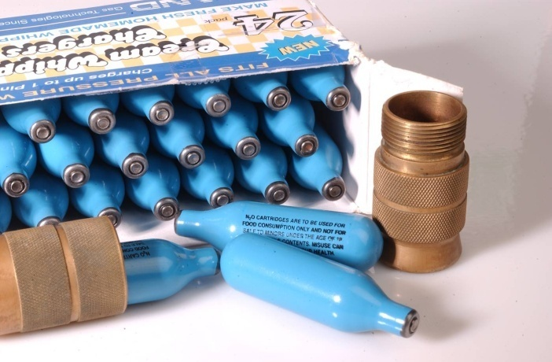
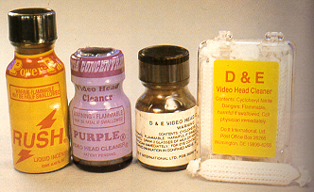
Inhalants
HGN
VGN
LOC

Slide 21
Inhalants
Pupil Size
Reaction to Light

Slide 22
Inhalants
Vital signs
Pulse rate
Blood pressure
Body temperature
Muscle tone

Slide 23
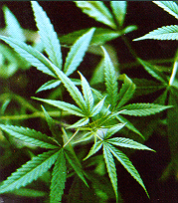
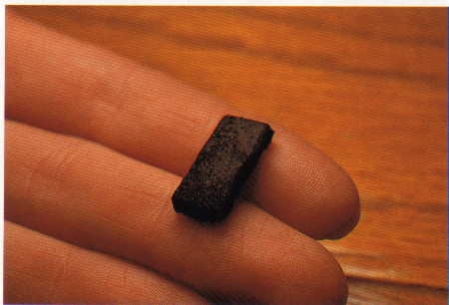
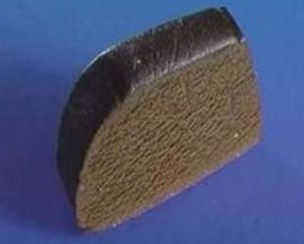
Cannabis
HGN
VGN
LOC

Slide 24
Cannabis
Pupil Size
Reaction to Light

Slide 25
Cannabis
Vital signs
Pulse rate
Blood pressure
Body temperature
Muscle tone

Slide 26
Wrap Up
Matrix summarizes major signs and indicators of drug influence observed by DREs

Slide 27
Questions?

